Slide 1


Improving the Accuracy
of Genome Assemblies
Sept. 20th 2013
Roy Ronen^{*,1}, Christina Boucher^{*,1}, Hamidreza Chitsaz² and Pavel Pevzner¹
1. University of California, San Diego
2. Wayne State University, Michigan
* Contributed equally to this work

Slide 2
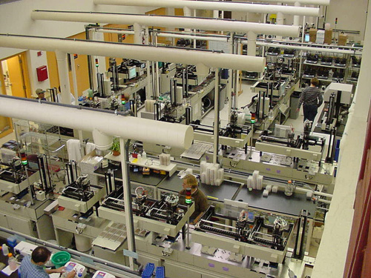
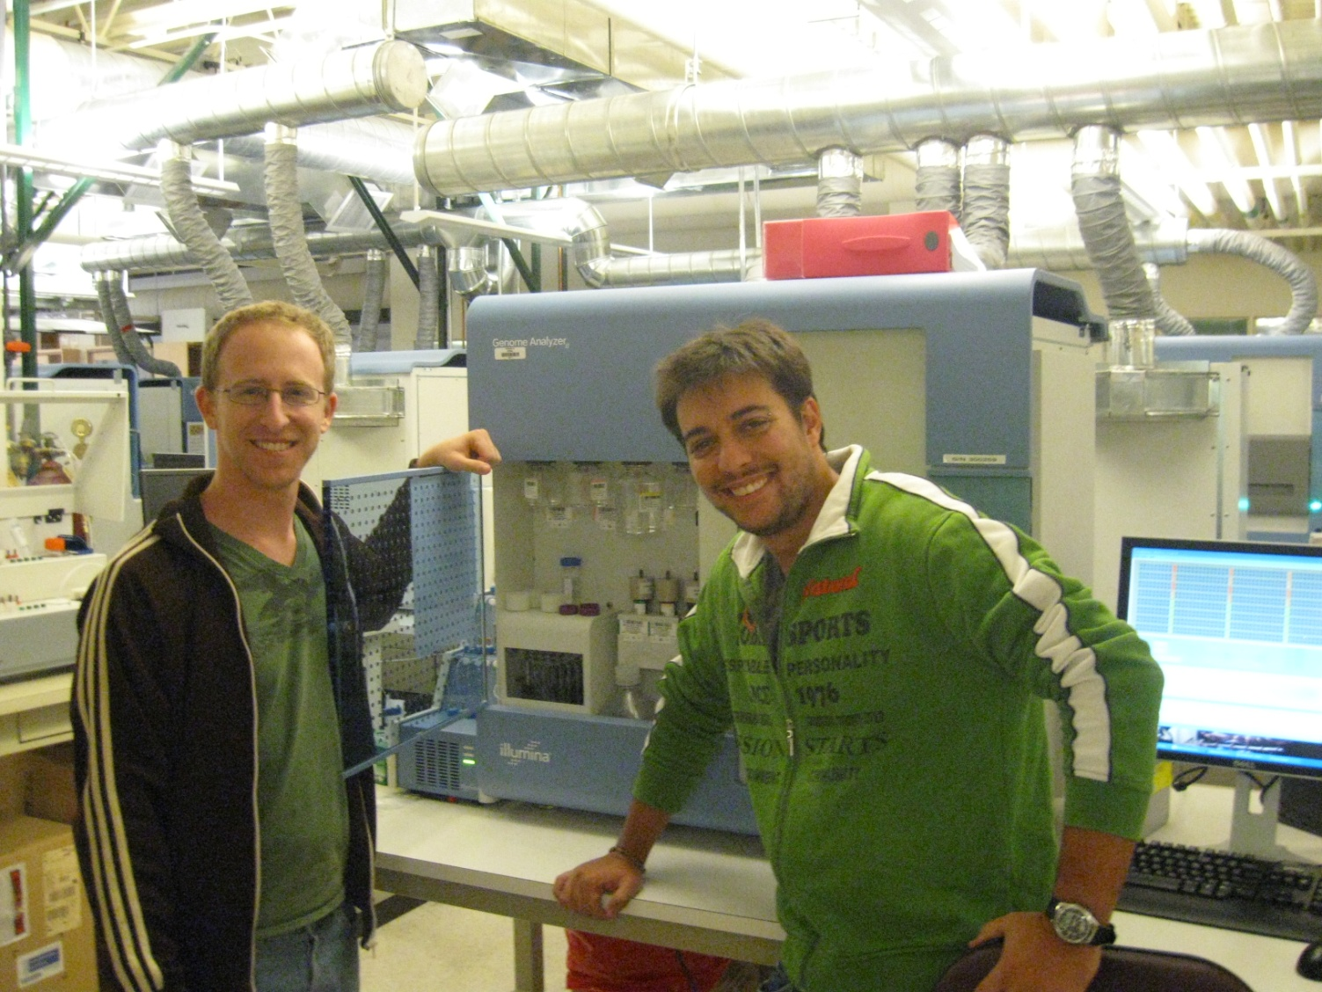
≈ $ thousands
≈ several weeks
≈ two people
≈ $ billions
≈ several years
≈ hundreds of people

Slide 3
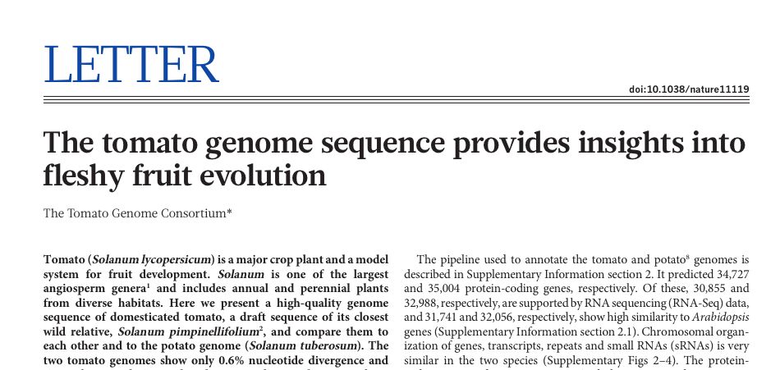
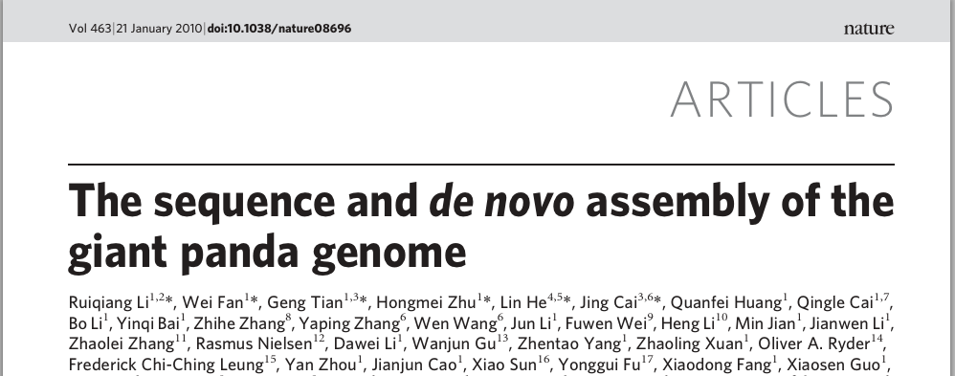
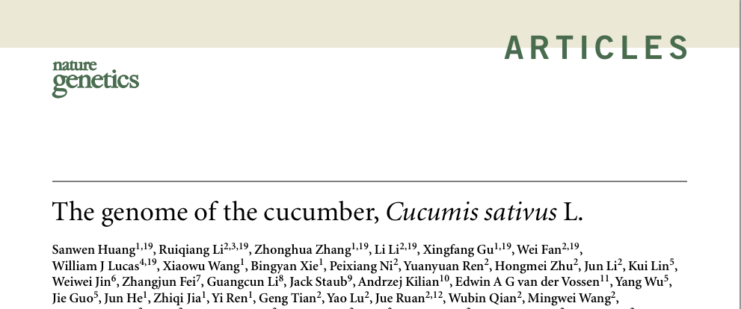



High Throughput Sequencing Assemblies

Slide 4

Draft Genome with HTS
Sample Preparation
Fragments
Sequencing
Reads
Assembly
Contigs
Analysis, Analysis,
Analysis

Slide 5
Sample Preparation
Fragments
Sequencing
HTS assemblies still contain an abundance of error:
20-30 subst. errors per 100kbp with SOAPdenovo.
5-20 subst. errors per 100kbp with Velvet.
Small (<50 bp) INDEL errors.
Misassembles, large INDELs, etc.
Reads
Assembly
Contigs
Analysis, Analysis,
Analysis

Slide 6
Sample Preparation
Fragments
Sequencing
Reads
Errors (macro & micro) in
the assembled contigs will profoundly affect
any downstream analysis
Assembly
Contigs
Analysis, Analysis,
Analysis

Slide 7
Sample Preparation
Fragments
Sequencing
Reads
SEQuel
Assembly
Contigs
Analysis, Analysis,
Analysis
Refined Contigs

Slide 8
De Bruijn Graph
for Fragment Assembly

Slide 9
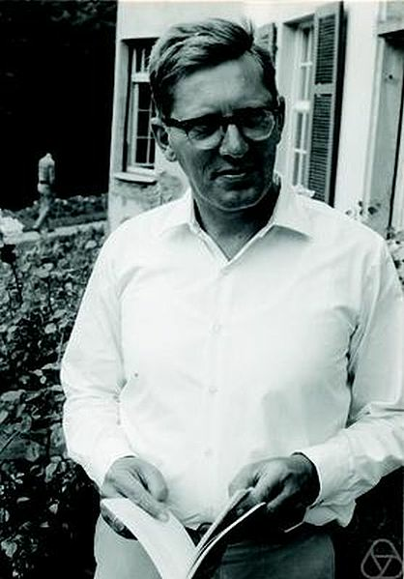
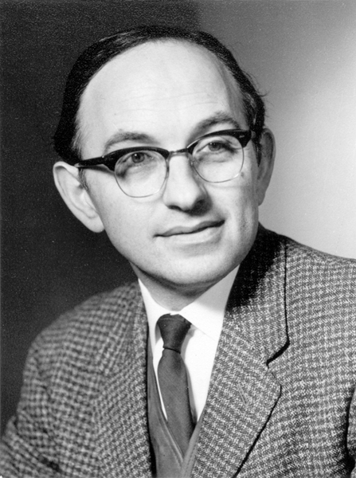

Nicolaas G. de Bruijn (1918-2012)
1946
Irving John Good (1916-2009)

Slide 10
De Bruijn Graph for Genome Assembly
Introduced in 1989.
Pevzner. J Biom Struc Dyn (1989) 7:63—73.
Idury & Waterman. J. Comput Biol (1995) 2:291—306.
Adapted to High Throughput Sequencing.
Feasibility: Chaisson, Tang & Pevzner. Bioinformatics. 2004!
…… then came the flood ……
Euler-SR: Chaisson & Pevzner. Genome Res. (2008) 18:324—30.
Velvet: Zerbino & Birney. Genome Res. (2008) 18:821—29.
ABySS: Simpson et al. Genome Res (2009) 19:1117—1123.
ALLPATHS: Gnerre et al. PNAS (2011) 108(4):1513—1518.
SPAdes: Bankevich et al. JCB (2012) 19(5):455—477.
… … …

Slide 11
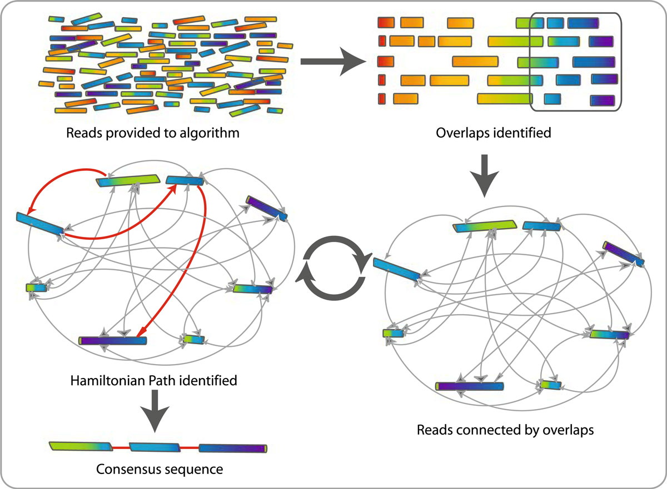
So, why the change of heart?
Even if OLC produces more accurate genomes, it is infeasible for HTS.

Slide 12
De Bruijn Graph
GCC
CCA
CCA
CAT
CAT
ATT
ATT
TTA
CCT
CTA
CTA
TAT
TAT
ATT
GCC
CCT
CCT
CTT
CTT
TTT
TTT
TTA
(Pevzner, Tang, Waterman 2001)

Slide 13
De Bruijn Graph
GCC
CCA
CCA
CAT
CAT
ATT
ATT
TTA
CCT
CTA
CTA
TAT
TAT
ATT
GCC
CCT
CCT
CTT
CTT
TTT
TTT
TTA
(Pevzner, Tang, Waterman 2001)

Slide 14
De Bruijn Graph
GCC
CCA
CAT
CAT
ATT
ATT
TTA
CCT
CTA
CTA
TAT
TAT
ATT
GCC
CCT
CCT
CTT
CTT
TTT
TTT
TTA
(Pevzner, Tang, Waterman 2001)

Slide 15
De Bruijn Graph
GCC
CCA
CAT
CAT
ATT
ATT
TTA
CTA
CTA
TAT
TAT
ATT
GCC
CCT
CTT
CTT
TTT
TTT
TTA
(Pevzner, Tang, Waterman 2001)

Slide 16
De Bruijn Graph
CCA
CAT
CAT
ATT
ATT
TTA
GCC
CTA
CTA
TAT
TAT
ATT
CCT
CTT
CTT
TTT
TTT
TTA
(Pevzner, Tang, Waterman 2001)

Slide 17
De Bruijn Graph

Slide 18
Challenges

Slide 19
GCC
CCT
CTA
TAG
AGG
GGA
GAC
CAC
ACT
CTT
TTG
TGG
GGC
GCA
GCCTAGGAC
CACTTGGCA
GCCTAGGAC
CACTTGGCA
GCCTAGGAC
CACTTGGCA
..............GCCTAGGAC.............CACTTGGCA..............

Slide 20
Sequencing errors cause Bulges in the de Bruijn graph
GCC
CCT
CTA
TAG
AGG
GGA
GAC
CAC
ACT
CTT
TTG
TGG
GGC
GCA
TGGA
TTGA
CTTG
CCTT
GCCTTGGAC
CACTTGGCA
GCCTAGGAC
CACTTGGCA
GCCTAGGAC
CACTTGGCA
..............GCCTAGGAC.............CACTTGGCA..............

Slide 21
Sequencing errors cause Bulges in the de Bruijn graph
2
2
2
CTA
TAG
AGG
2
3
3
GCC
CCT
GGA
GAC
1
1
4
4
CTT
TTG
TGG
CAC
ACT
3
3
GGC
GCA
3
3
GCCTTGGAC
CACTTGGCA
GCCTAGGAC
CACTTGGCA
GCCTAGGAC
CACTTGGCA
..............GCCTAGGAC.............CACTTGGCA..............

Slide 22
Sequencing errors cause Bulges in the de Bruijn graph
3
3
GCC
CCT
GGA
GAC
1
1
4
4
CTT
TTG
TGG
CAC
ACT
3
3
GGC
GCA
3
3
......GCCTTGGAC......
......CACTTGGCA......
GCCTTGGAC
CACTTGGCA
GCCTAGGAC
CACTTGGCA
GCCTAGGAC
CACTTGGCA
..............GCCTAGGAC.............CACTTGGCA..............

Slide 23
The SEQuel Algorithm

Slide 24
The SEQuel Algorithm
53
12
19
25
32
40
8
21
29
34
21
26
34
39
44
57
68
75
81
89
Permissively aligned read pair: a read-pair for which at least one read aligned uniquely.

Slide 25
Positional De Bruijn Graph
Positional k-mer: a pair (k-mer, position), e.g. (GCCA, 111).
GCC,111
CCA,112
CCA,112
CAT,113
CAT,113
ATT,114
ATT,114
TTA,115
CCT,112
CTT,113
CTT,113
TTT,114
TTT,114
TTA,115
GCC,975
CCT,976
CCT,976
CTA,977
CTA,977
TAT,978
TAT,978
ATT,979

Slide 26
Positional De Bruijn Graph
GCC,111
CCA,112
CCA,112
CCA,112
CAT,113
CAT,113
ATT,114
ATT,114
ATT,114
TTA,115
CCT,112
CTT,113
CTT,113
TTT,114
TTT,114
TTA,115
GCC,975
CCT,976
CCT,976
CTA,977
CTA,977
TAT,978
TAT,978
ATT,979
ATT,979

Slide 27
Positional De Bruijn Graph
4
4
4
4

Slide 28
The SEQuel Algorithm
partial contig #1
partial contig #2

Slide 29
The SEQuel Algorithm
GTATTCCGAGGACCACTGGATTATGA
29

Slide 30
The SEQuel Algorithm
GTATTCCGAGGACCAC---TGGATTATGA
GCGGGCCGAGGA
CAAATGGATTACGA
30

Slide 31
The SEQuel Algorithm
GTATTCCGAGGACCAC---TGGATTATGA
GCGGGCCGAGGA
CAAATGGATTACGA
31

Slide 32
The SEQuel Algorithm
GCGGGCCGAGGACCAC---TGGATTATGA
GCGGGCCGAGGA
CAAATGGATTACGA
32

Slide 33
The SEQuel Algorithm
GCGGGCCGAGGACCAC---TGGATTATGA
GCGGGCCGAGGA
CAAATGGATTACGA
33

Slide 34
The SEQuel Algorithm
GCGGGCCGAGGACCACAAATGGATTACGA
GCGGGCCGAGGA
CAAATGGATTACGA
34

Slide 35
The SEQuel Algorithm
GCGGGCCGAGGACCACAAATGGATTACGA
Repeat for all contigs.
35

Slide 36
Results
Standard and Single-Cell E. coli.
100 bp paired-end, Illumina (GAII) reads.
Mean coverage ≈ 600x.
Assemblies compared to reference with & without SEQuel.

Slide 37
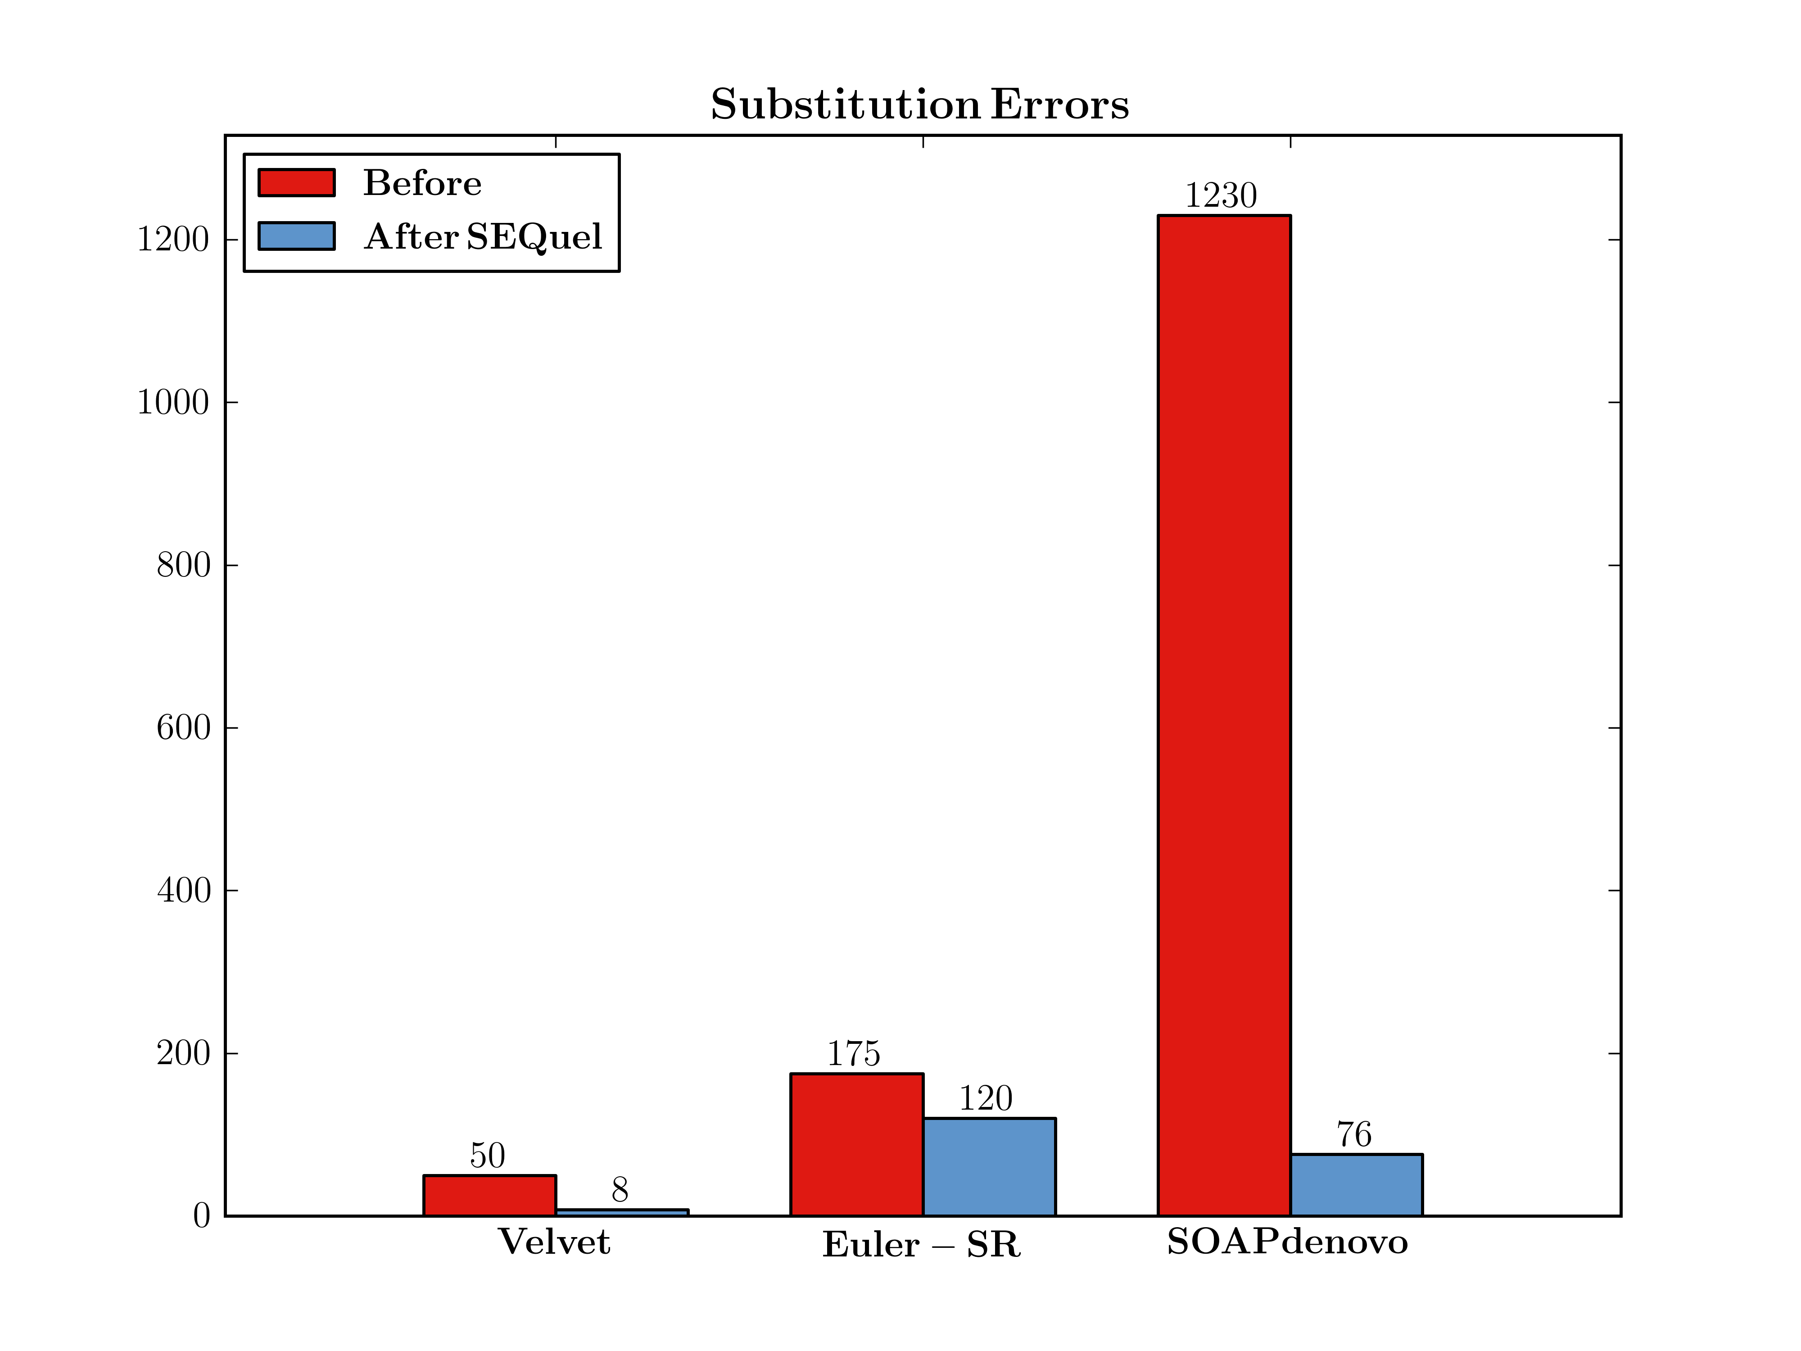
Standard E. coli

Slide 38
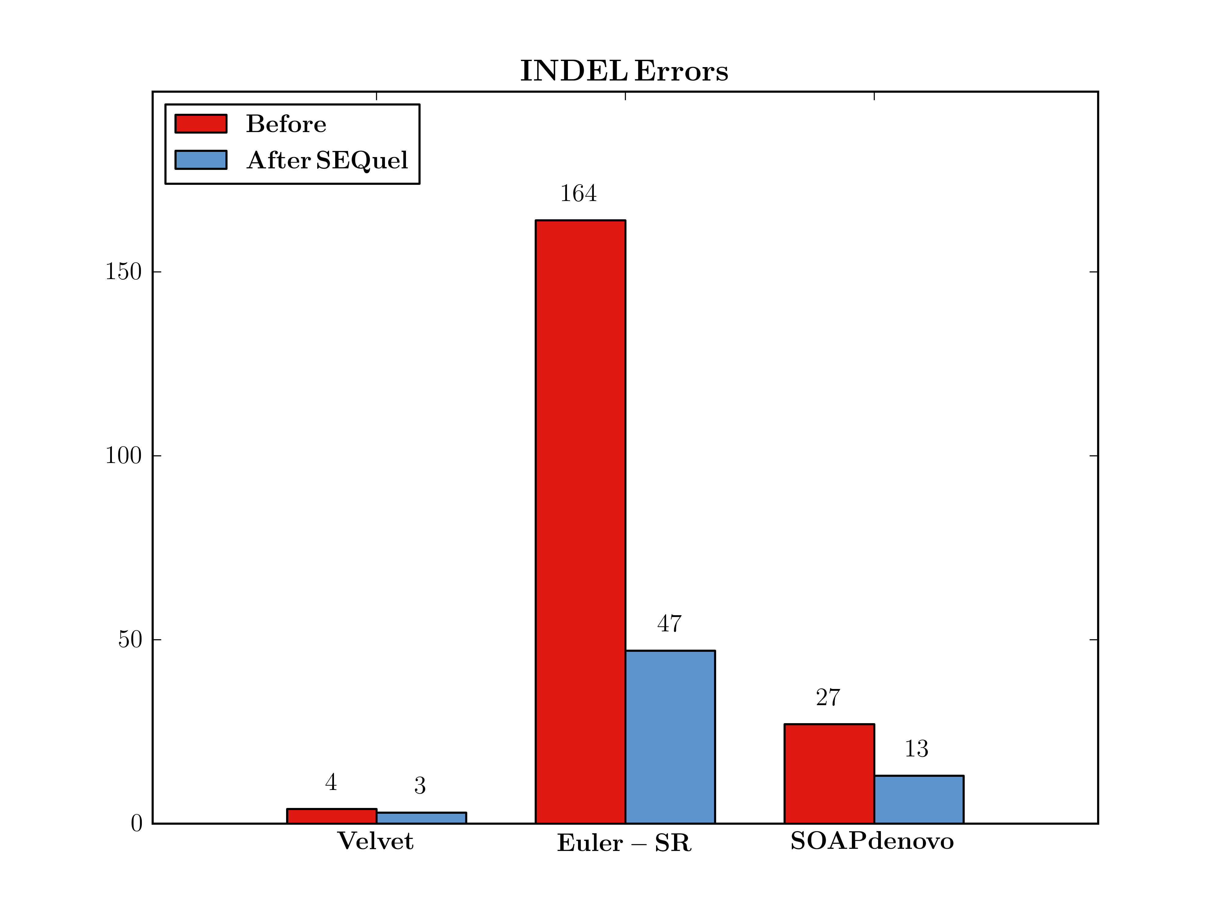
Standard E. coli

Slide 39
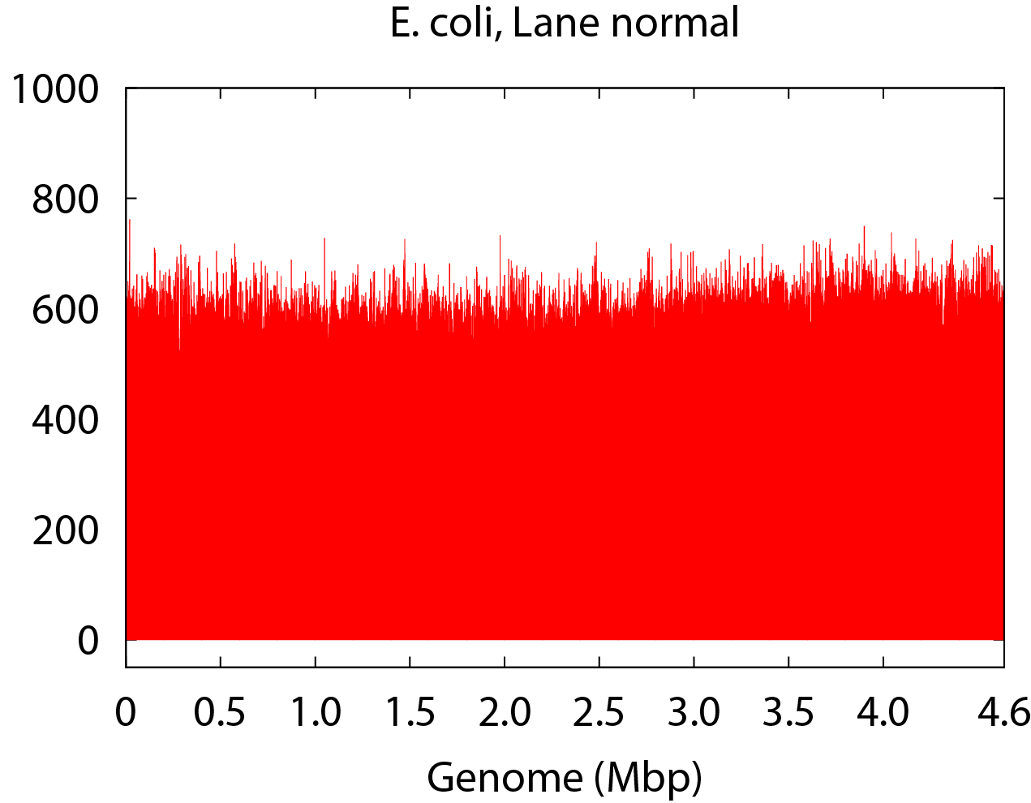
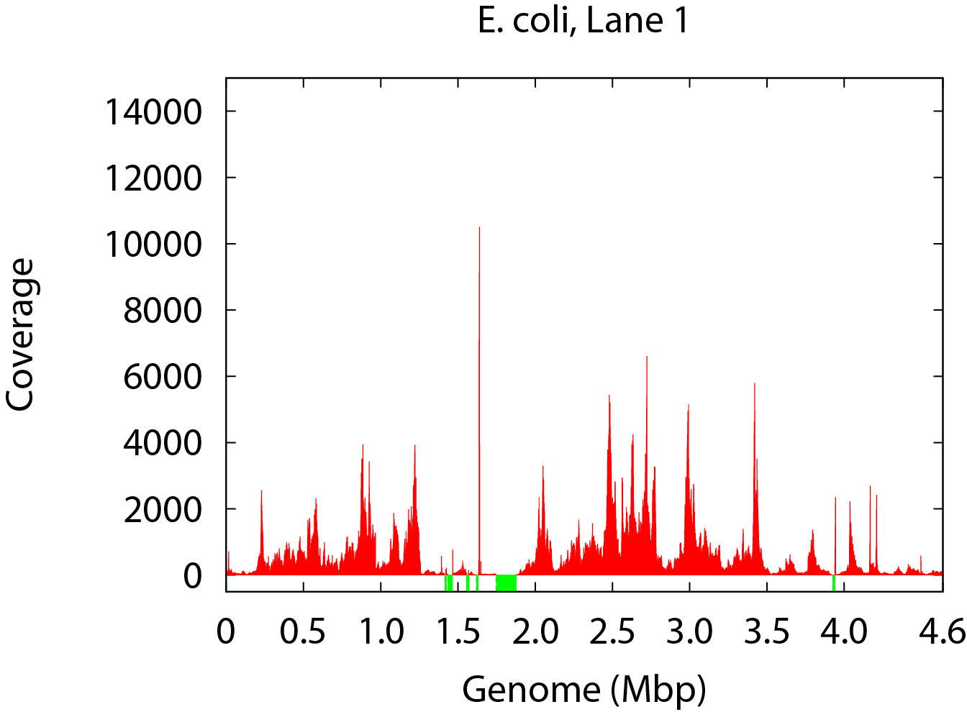
Single Cell Sequencing
Standard
Single Cell
(Chitsaz et al., 2011)

Slide 40
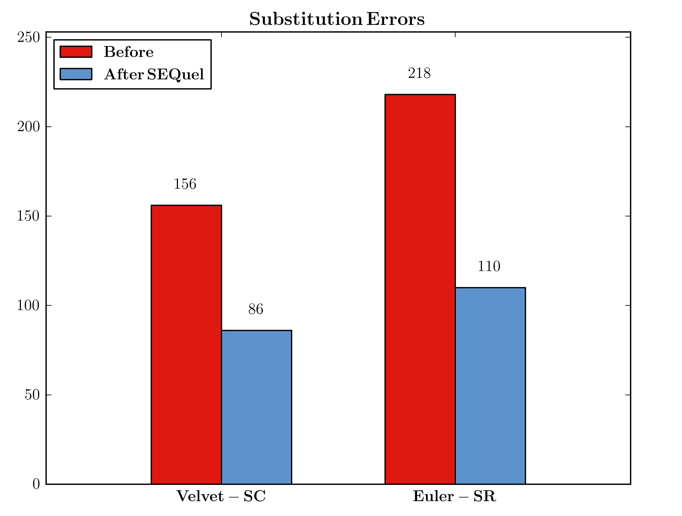
Single Cell E. coli

Slide 41
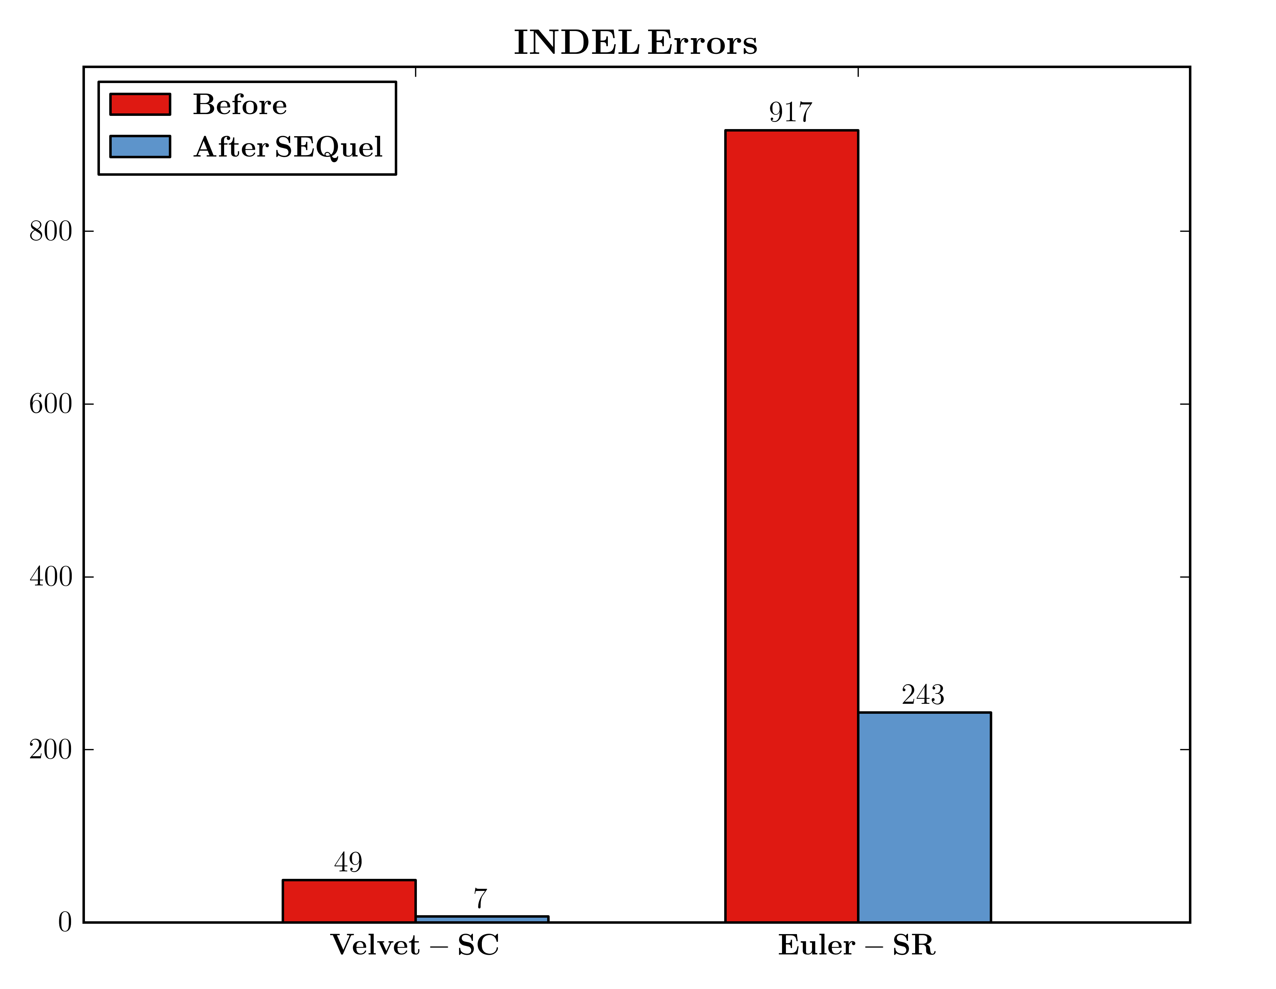
Single Cell E. coli

Slide 42
Summary
Removed 35% to 96% of small-scale assembly errors.
Introduced positional de Bruijn graph for contig refinement.
Demonstrated utility in hard (single-cell) assembly.
SEQuel can be used in combination with any assembler.
Freely available at: http://bix.ucsd.edu/SEQuel

Slide 43
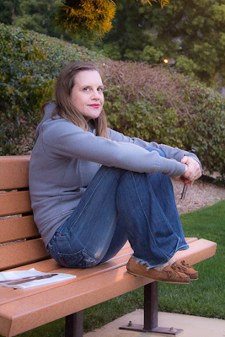


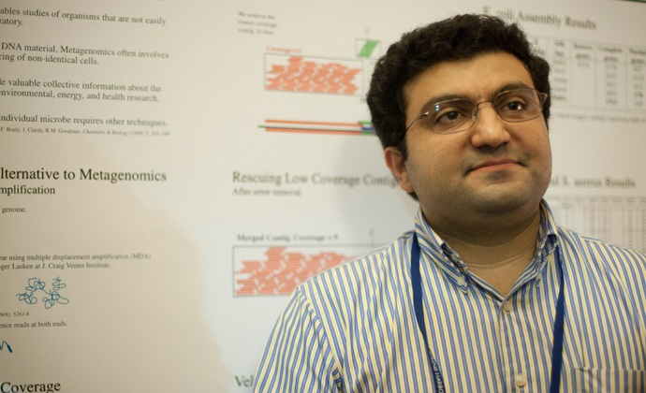
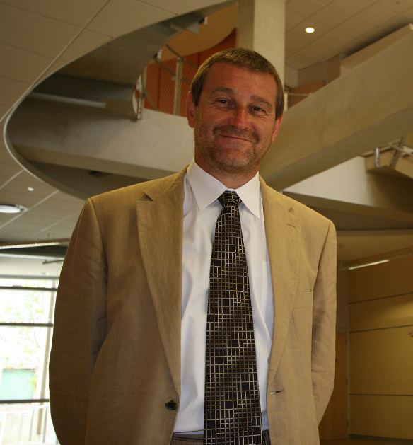

Acknowledgments
Christina Boucher
Hamidreza Chitsaz
Pavel Pevzner
3P41RR024851-02S1
CCF-1115206

